Slide 1







Enterprise Blockchain Developers (Intermediate)
In support of
Powered By

Slide 2
Outline
Proxy
3 Design Patterns
Factory Code Demo
Upgradeable Factory Demo
© 2017-2020 SmartMesh Foundation Pte. Ltd. | MeshBox Foundation Pte. Ltd.

Slide 3
Dive into Proxy (Architect a Solidity Program)
(Code Explain) https://github.com/OpenZeppelin/openzeppelin-sdk/tree/master/packages/lib/contracts/upgradeability
proxy
BaseUpgrabdeablity Proxy
InitializableUpgrabdeablity Proxy
BaseAdminUpgrabdeablity Proxy
Upgrabdeablity Proxy
InitializableAdminUpgrabdeablity Proxy
AdminUpgrabdeablity Proxy
Proxy Factory
Proxy Admin

Slide 4
Dive into Proxy (Architect a Solidity Program)
Proxy: fall back and delegateCall;
proxy no parent class
function () payable external { _fallback();}
function _implementation() internal view returns (address); (abstract class)
function _delegate(address implementation) internal {assembly }
function _willFallback() internal {} (abstract class)
function _fallback() internal {
_willFallback();
_delegate(_implementation());
}
BaseUpgradeabilityProxy: no initializer or contractor, has upgradeto & impl slot
(Code Explain) https://github.com/OpenZeppelin/openzeppelin-sdk/tree/master/packages/lib/contracts/upgradeability

Slide 5
Dive into Proxy (Architect a Solidity Program)
BaseUpgradeabilityProxy: no initializer or constructor, has upgradeto & impl slot
what is usage of initializer or constructor?
constructor is used to initialized data, initializer function is a normal function, so it can be called after the instance gets created.
contract BaseUpgradeabilityProxy is Proxy (Inherit from Proxy)
bytes32 internal constant IMPLEMENTATION_SLOT = 0x360894a13ba1a3210667c828492db98dca3e2076cc3735a920a3ca505d382bbc; This is the keccak-256 hash of "eip1967.proxy.implementation" subtracted by 1, and is validated in the constructor (reserved slot for implimentation contract)
function _implementation()
function _upgradeTo(address newImplementation) internal
function _setImplementation(address newImplementation) internal

Slide 6
Dive into Proxy (Architect a Solidity Program)
InitializableUpgradebilityProxy: with initializer & Initialize the impl address
BaseAdminUpgradeabilityProxy: Add admin, no Initializer
UpgradeabilityProxy: with constructor and set the impl slot (Code Explain)
proxy
BaseUpgrabdeablity Proxy
InitializableUpgrabdeablity Proxy
BaseAdminUpgrabdeablity Proxy
Upgrabdeablity Proxy
InitializableAdminUpgrabdeablity Proxy
AdminUpgrabdeablity Proxy
Proxy Factory
Proxy Admin

Slide 7
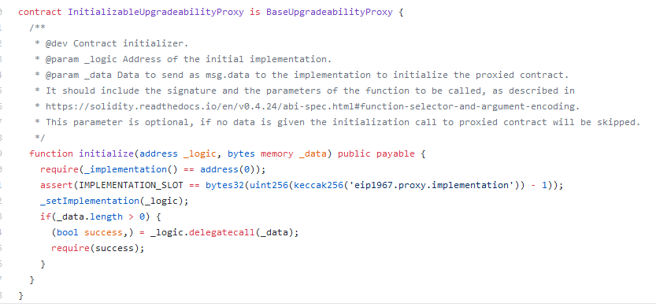
Dive into Proxy (Architect a Solidity Program)
InitializableUpgradebilityProxy: with initializer & Initialize the impl address
can flexiablely initialize logic contract

Slide 8
Dive into Proxy (Architect a Solidity Program)
BaseAdminUpgradeabilityProxy: Add admin, no Initializer
Admin is to manage the implementation logic contract
contract BaseAdminUpgradeabilityProxy is BaseUpgradeabilityProxy {
function admin() external ifAdmin returns (address) {
function implementation() external ifAdmin returns (address) {
function changeAdmin(address newAdmin) external ifAdmin {
function upgradeTo(address newImplementation) external ifAdmin { (without init data)
function upgradeToAndCall(address newImplementation, bytes calldata data) payable external ifAdmin { (with init data)
function _admin() internal view returns (address adm) {
function _setAdmin(address newAdmin) internal {

Slide 9
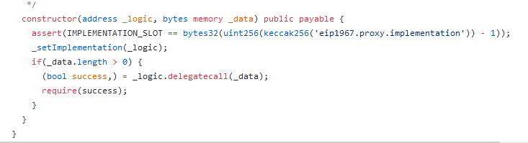
Dive into Proxy (Architect a Solidity Program)
UpgradeabilityProxy: with constructor and set the impl slot
so this is not a upgradeable contract. just a proxy

Slide 10
Dive into Proxy (Architect a Solidity Program)
So the differences are:
InitializableUpgradebilityProxy is just used to initialized impl contract
BaseAdminUpgradeabilityProxy: is proxy admin
UpgradeabilityProxy: the proxy for upgradeable contracts

Slide 11
Dive into Proxy (Architect a Solidity Program)
InitializableAdminUpgradebilityProxy: Initialize the impl and set admin address
AdminUpgradeabilityProxy: with constructor and set admin add
(Code Explain)
proxy
BaseUpgrabdeablity Proxy
InitializableUpgrabdeablity Proxy
BaseAdminUpgrabdeablity Proxy
Upgrabdeablity Proxy
InitializableAdminUpgrabdeablity Proxy
AdminUpgrabdeablity Proxy
Proxy Factory
Proxy Admin

Slide 12
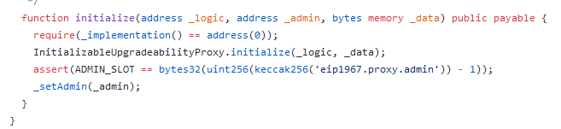
Dive into Proxy (Architect a Solidity Program)
InitializableAdminUpgradebilityProxy: Initialize the impl and set admin address
can set and manage admin and initialize logic contract

Slide 13
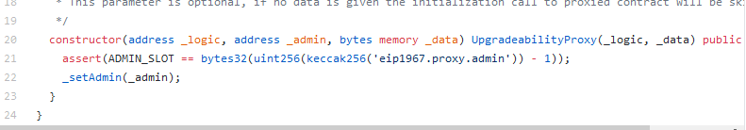
Dive into Proxy (Architect a Solidity Program)
AdminUpgradeabilityProxy: with constructor and set admin add

Slide 14
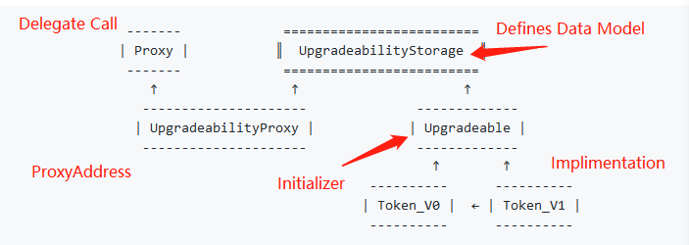
Dive into Proxy (Architect a Solidity Program)
Inherited, Unstructured, External Storage, ProxyFactory and ProxyAdmin
(Code Explain) https://github.com/OpenZeppelin/openzeppelin-labs
Inherited
What does it mean by upgradability? there is a initializer in the smartcontract or there are no constructor / initializer

Slide 15
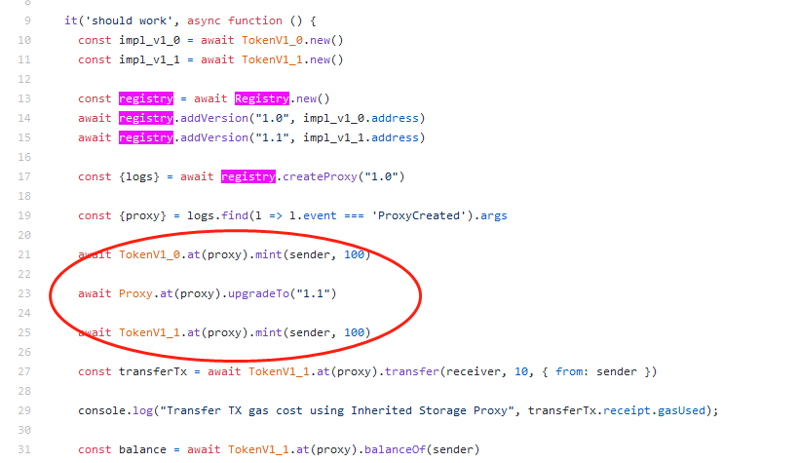
Dive into Proxy (Architect a Solidity Program)
All the logic and proxy contracts share a same address
data stored in proxy address

Slide 16
Dive into Proxy (Architect a Solidity Program)
Drawbacks:
Data Model cannot be changed, can only be updated or add new features
(Code Explain)

Slide 17
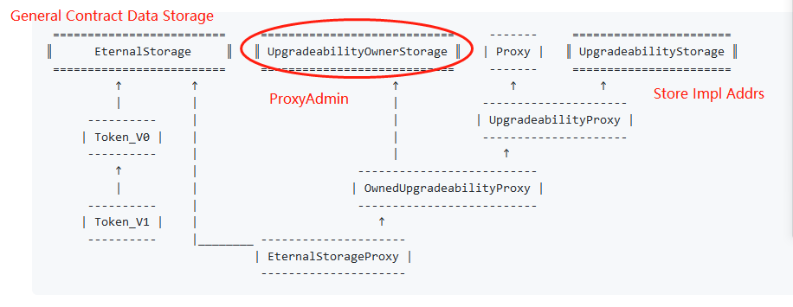
Dive into Proxy (Architect a Solidity Program)
Eternal Storage
(Code Explain)

Slide 18
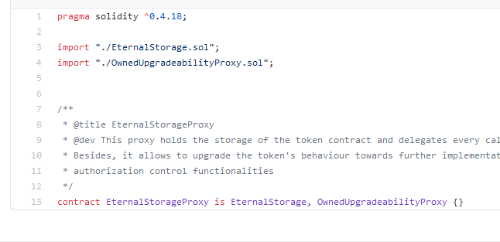
Dive into Proxy (Architect a Solidity Program)
All the data stores in EternalStorageProxy

Slide 19
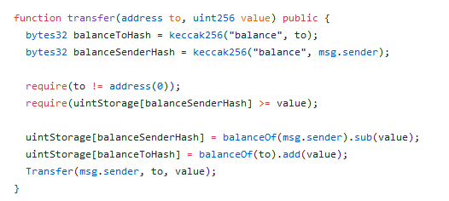
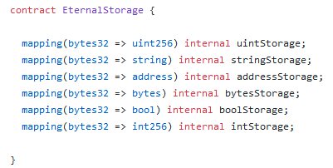
Dive into Proxy (Architect a Solidity Program)
Eternal Storage: The data type is general, need to rewrite the functions

Slide 20
Dive into Proxy (design a Solidity Program)
Pros:
The actural impl contract's data structure doesn't need to follow the previous impl contract's data structure
Cons:
Hard to write, as we need to extract all the data storing out

Slide 21
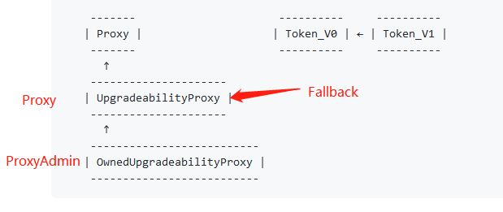

Dive into Proxy (Architect a Solidity Program)
Unstructured
(Code Explain)
The idea here is to use fixed storage slots to store the required data for upgradeability purpose, this is the upgradeability owner and the implementation address

Slide 22
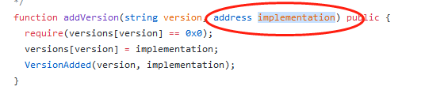

Dive into Proxy (Architect a Solidity Program)
Unstructured
Use pregenerated impl address
Use fixed impl address

Slide 23
Dive into Proxy (Architect a Solidity Program)
ProxyAdmin & ProxyFactory (Code Explain)
Check if IniupgradProxy and AdminUpgradeProx have initializer (Inherited with admin)
Unstructured Storage has contrustor, so can use upgradeto without init data
proxy
BaseUpgrabdeablity Proxy
InitializableUpgrabdeablity Proxy
BaseAdminUpgrabdeablity Proxy
Upgrabdeablity Proxy
InitializableAdminUpgrabdeablity Proxy
AdminUpgrabdeablity Proxy
Proxy Factory
Proxy Admin

Slide 24
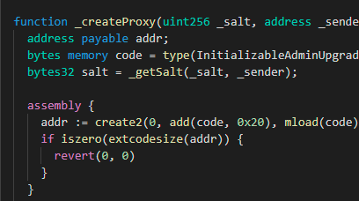
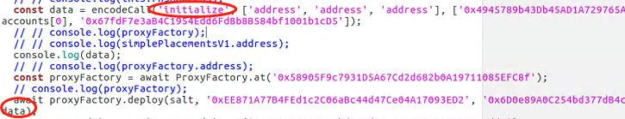
Dive into Proxy (Architect a Solidity Program)
Explain the code
Proxy:
miniDeploy
deploy
Salt
Creates a proxy
Proxy admin
upgradeto vs upgradeToAndCall

Slide 25
Factory and Proxy Pattern
What Is the Factory Pattern?
The idea of the factory pattern is to have a contract (the factory) that will carry the mission of creating other contracts.
Why Use the Factory Pattern in Solidity?
1 If you want to create multiple instances of the same contract and you’re looking for a way to keep track of them and make their management easier.
2 Save gas on deployment: You can deploy only the factory and use it later to deploy the other contracts.
3 Improve contract security: make logic simpler, upgradeable, so safer.

Slide 26
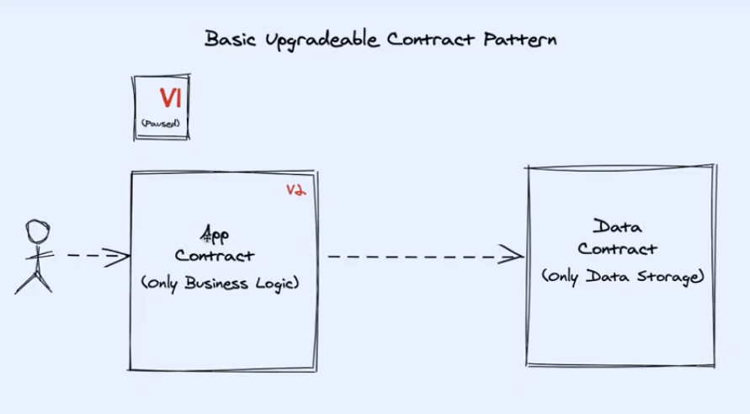
Factory and Proxy Pattern

Slide 27
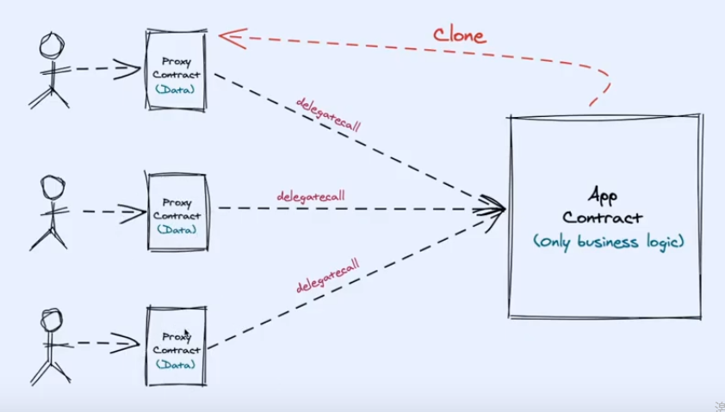
Factory and Proxy Pattern

Slide 28
Code Demo
Tasks:
1. Add Proxy admin and Proxy Factor to PrivateStamp
2. Explain Aave's contract
3. Add version to make Proxy upgradeable

